Slide 1

SQL for Data Science Capstone Project on Sportstats using Olympics Dataset
University of California
Davis
Submitted by :-

Slide 2
Project uses Olympic Dataset of SportStats
Following tables are used in Analysis
athlete_events
noc_regions
costperathleteandevent
country_year_medal
countryathletecount
countryyearmedalcountquery
olympicpergamedetail
introduction_of_women_olympic_sports
womens_participation_in_the_games_of_the_olympiad
womens_participation_in_the_olympic_winter_games
outturncost
new_sql_query

Slide 3
Target Audience
Sports Authorities
Sportsmen/Sportswomen/Teams
Media Personnel covering sports
Individual with interest in Sports
Sponsors of Sports events and individuals
Individuals wishing to pursue sports as carrier
Fans Sport Stars

Slide 4
Reason for Analysis & Presentation
Drawing attention of Authorities for comparison
Focusing areas requiring attention of Sports persons/Teams
Providing input to Media for public at large
Providing Analytical report to anyone interested in Sports
Providing qualitative inputs to sponsors
Exploring opportunities to those pursuing Sports as carrier
Giving input to Fans of Sport Stars

Slide 5
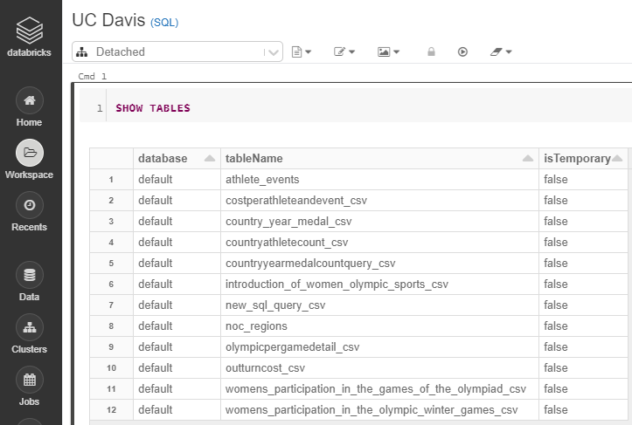
Tables used for Analysis & Visualizations

Slide 6
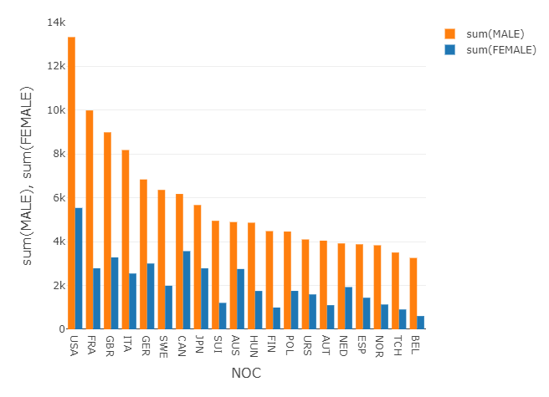
Top 20 countries participation-wise

Slide 7
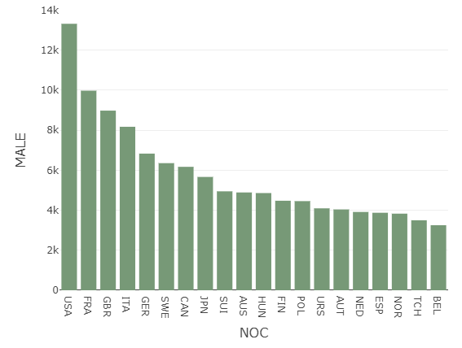
Participation of Male- Top 20 countries
We observe that USA in number one and France is second.

Slide 8
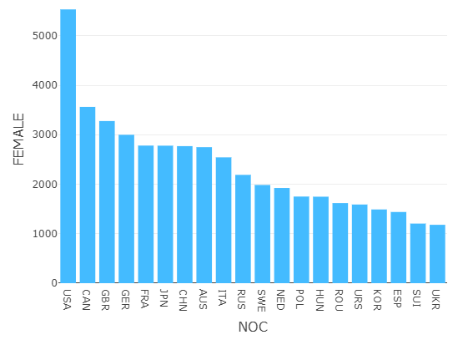
Participation of Female- Top 20 countries
We observe that USA in number one and Canada is second.

Slide 9
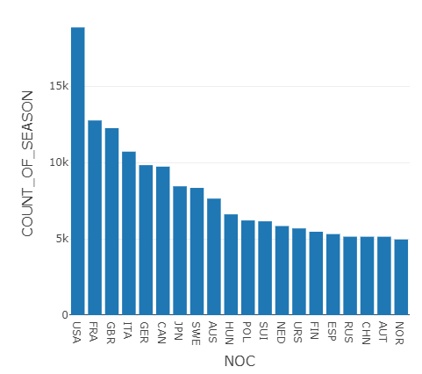
Seasonwise & NOC-wise Distribution

Slide 10
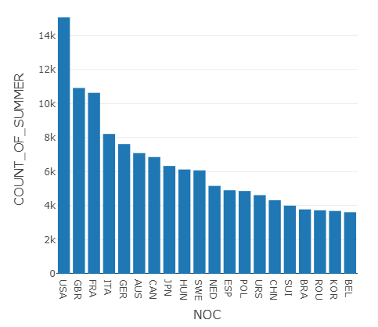
Distribution of Summer Events

Slide 11
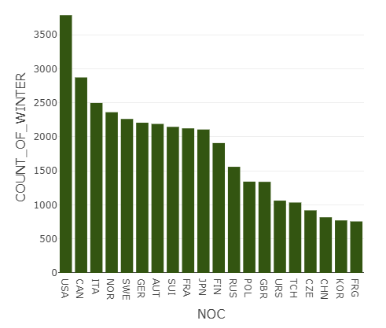
Distribution of Winter Events

Slide 12
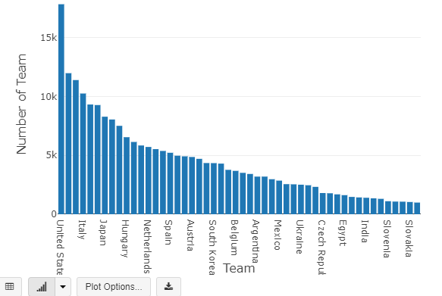
Top 20Participating Teams

Slide 13
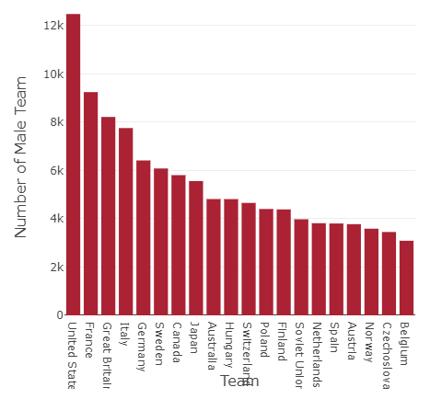
Top 20 Participating Male Teams

Slide 14
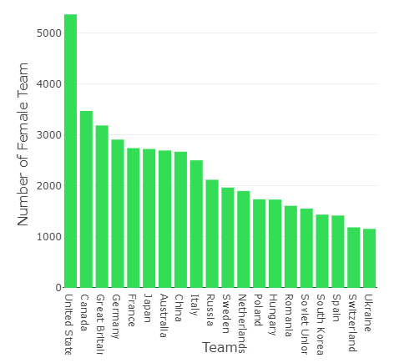
Top 20 Participating Female Teams

Slide 15
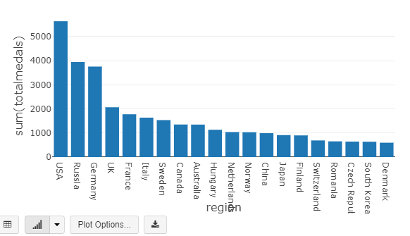
Top 20 Medal Winning Countries

Slide 16
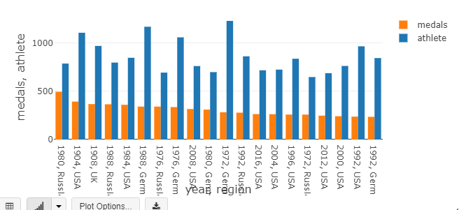
Top 20 athlete and Medal won- Year wise, Country wise

Slide 17
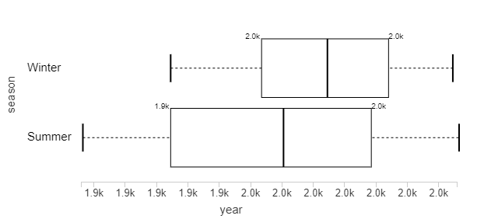
Year wise Seasonal distribution of Olympics

Slide 18
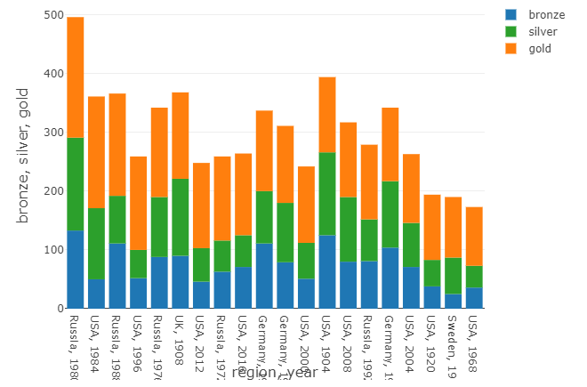
Top 20-Gold, Silver & Bronze Medalist

Slide 19
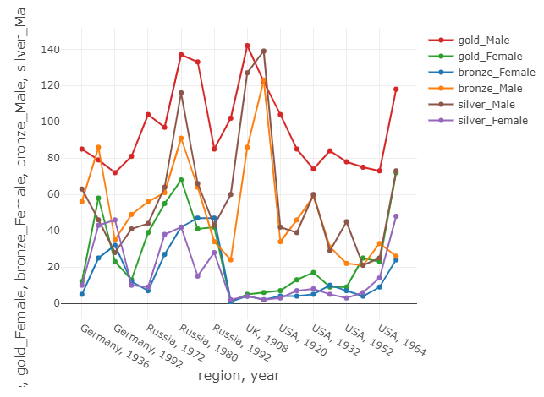
Top 20 Male Female Medalist Countries

Slide 20
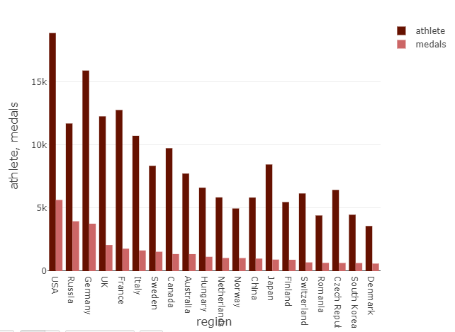
Top 20 total athletes and Medal Won

Slide 21
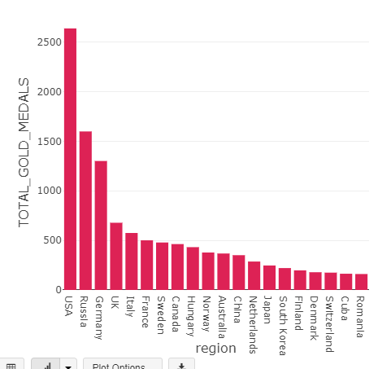
Top 20 Gold Medalist Countries

Slide 22
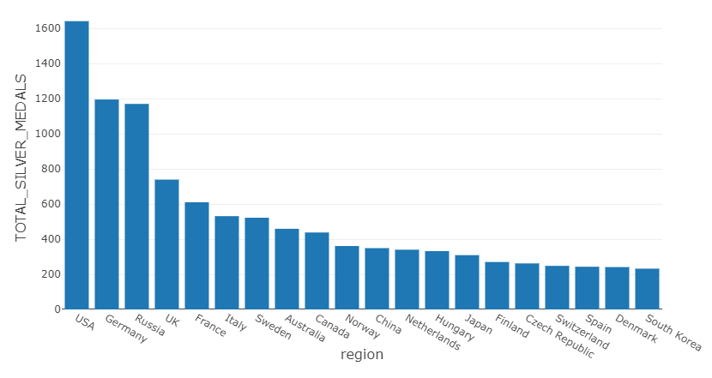
Top 20 Silver Medalist Countries

Slide 23
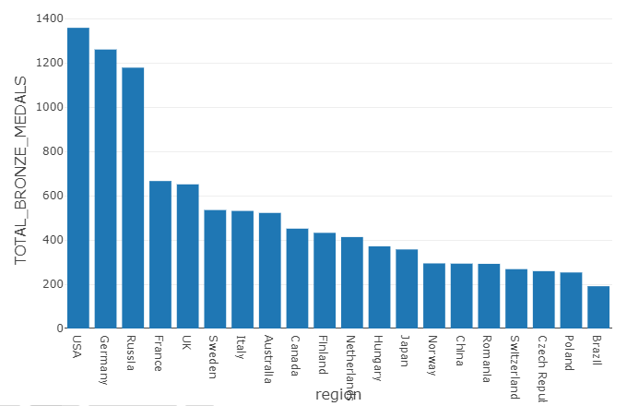
Top 20 Bronze Medalist Countries

Slide 24
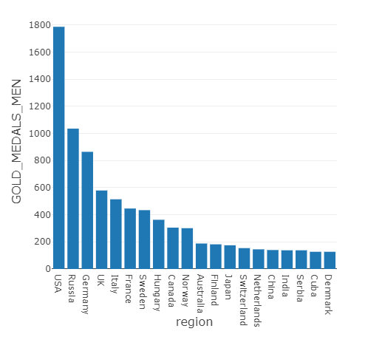
Top 20 Gold Medal(Male)-Country wise

Slide 25
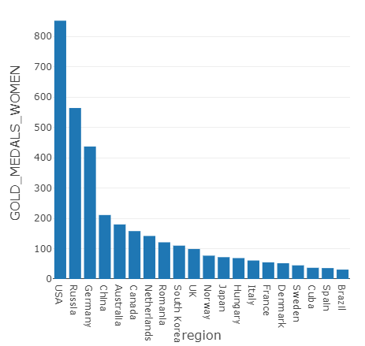
Top 20 Gold Medal (Female)-Country wise

Slide 26
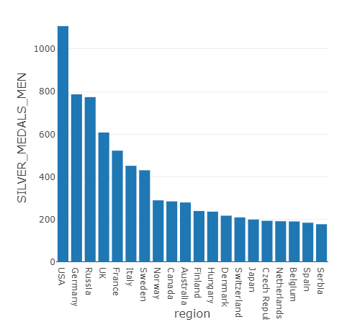
Top 20 Silver Medal-Country wise

Slide 27
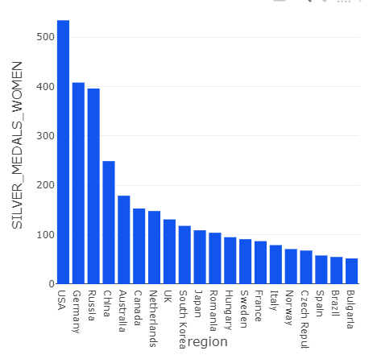
Top 20 Silver Medal (Female) Country wise

Slide 28
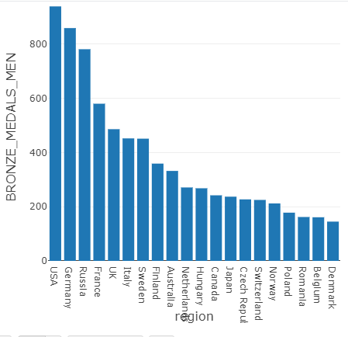
Top 20 Bronze Medal (Male) Countries

Slide 29
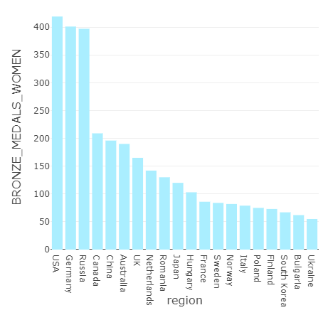
Top 20 Bronze Medal (Female) Country wise

Slide 30
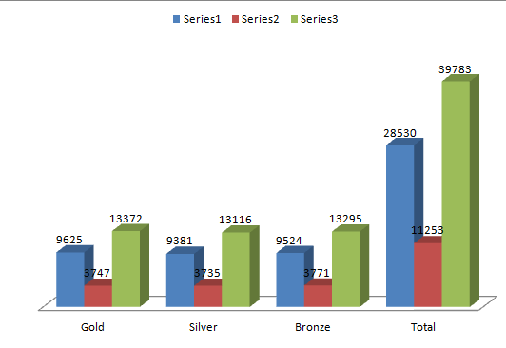
Total Medal Distribution among Male Female
 | Gold | Silver | Bronze | Total
Male | 9625 | 9381 | 9524 | 28530
Female | 3747 | 3735 | 3771 | 11253
Total | 13372 | 13116 | 13295 | 39783

Slide 31
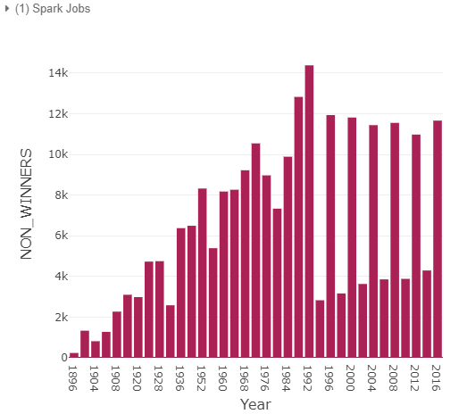
Year wise Non winners

Slide 32
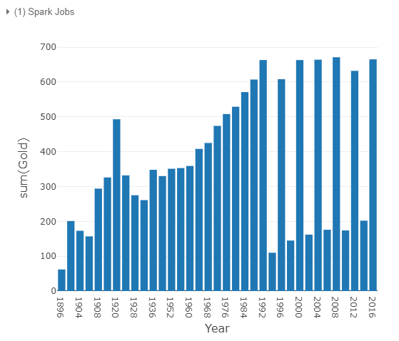
Year wise Gold Winners

Slide 33
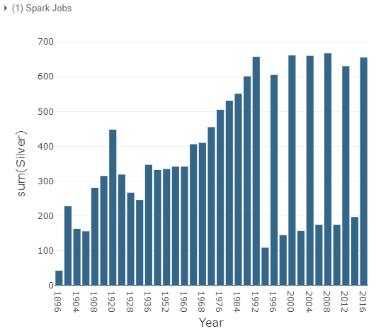
Year wise Silver Winners

Slide 34
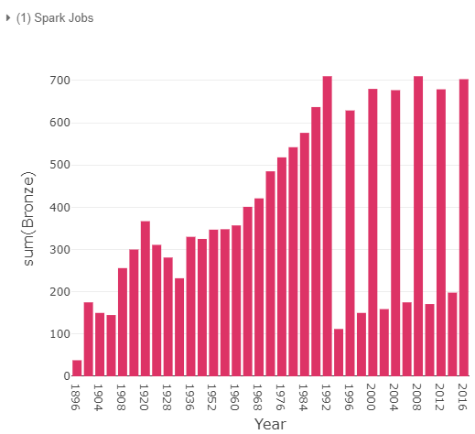
Year wise Bronze Winners

Slide 35
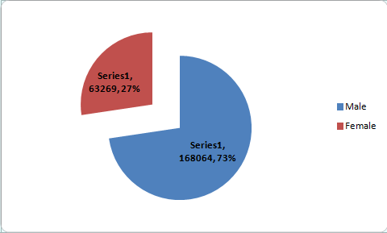
Male Female Non Winners
Total Non Winners are 231333, out of which Male constitute 73% and Female constitute 27%.

Slide 36
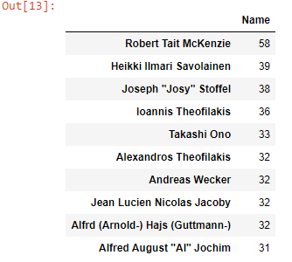
Top Ten Participants

Slide 37
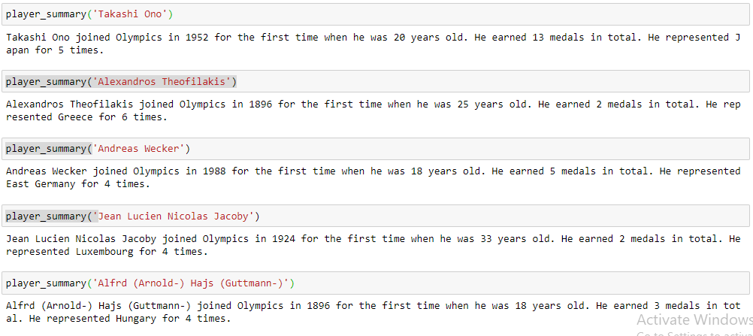
Achievements of Top Ten Participants

Slide 38
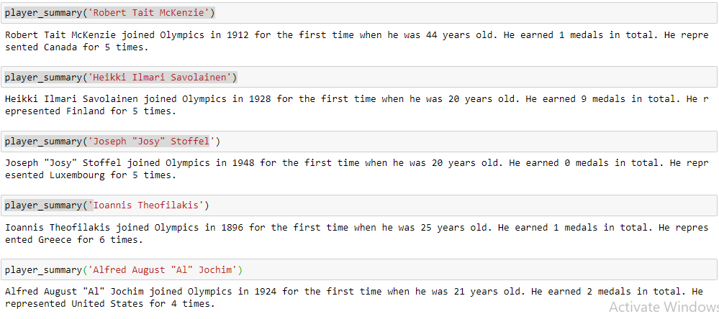
Achievements of Top Ten Participants

Slide 39
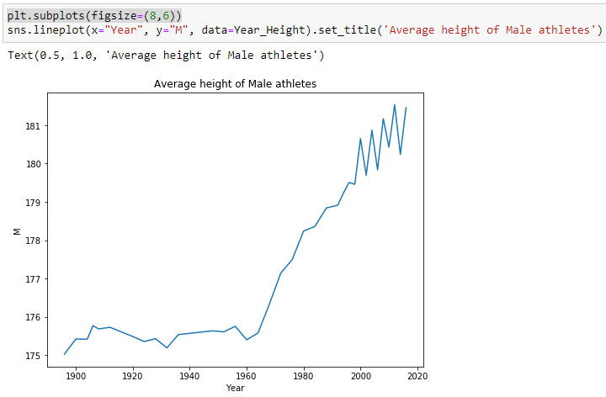
Average Height of Male Athletes

Slide 40
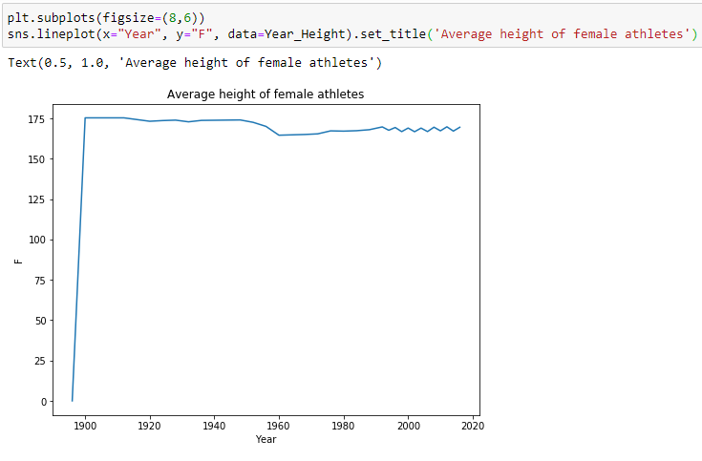
Average Height of Female Athletes

Slide 41
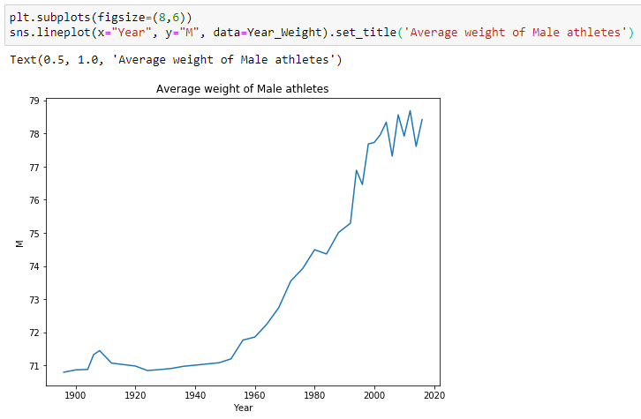
Average Weight of Male Athletes

Slide 42
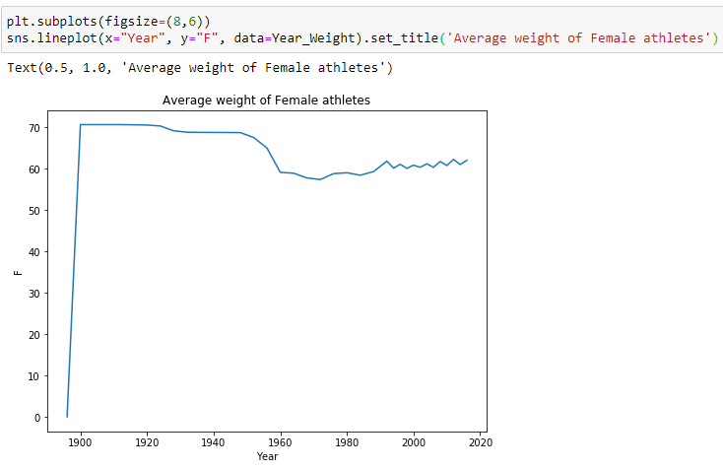
Average Weight of Female Athletes

Slide 43
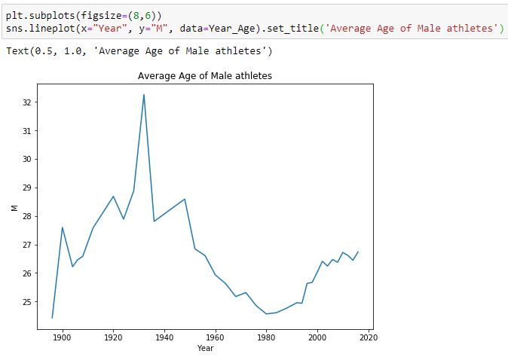
Average Age of Male Athletes

Slide 44
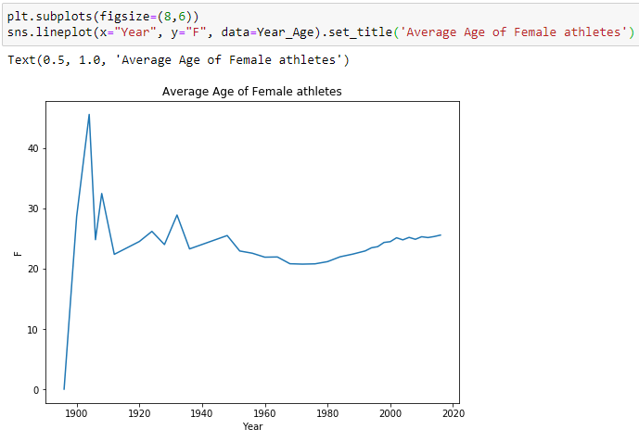
Average Age of Female Athletes

Slide 45
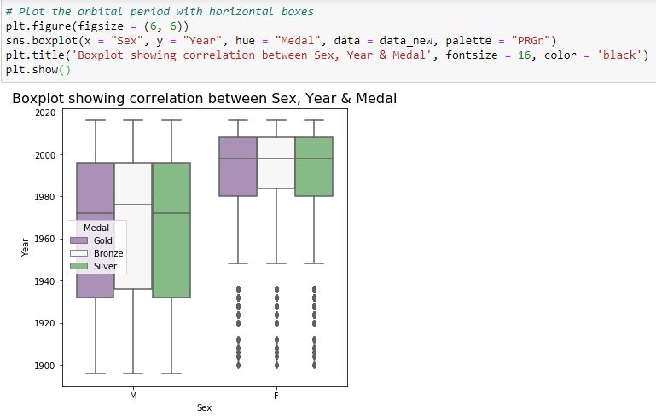
Medal distribution among Male and Female Winners using Boxplot

Slide 46
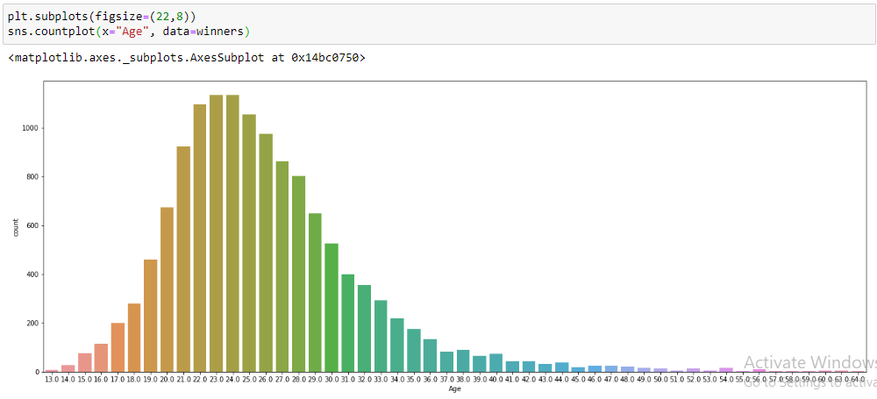
Countplot-Agewise distribution of Medalists

Slide 47
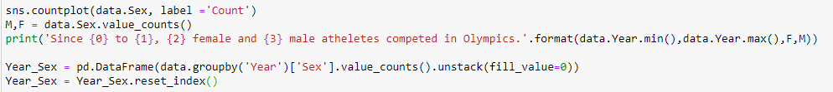
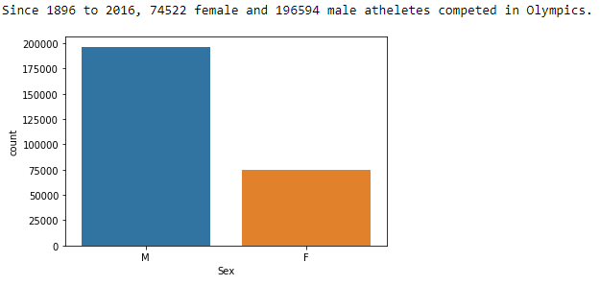
Sexwise count of Participants

Slide 48
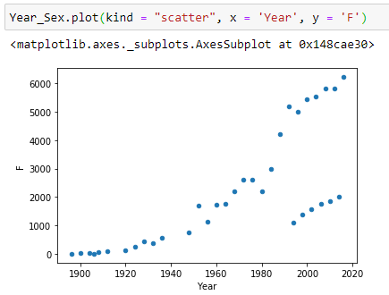
Scatter plot of Female Participants

Slide 49
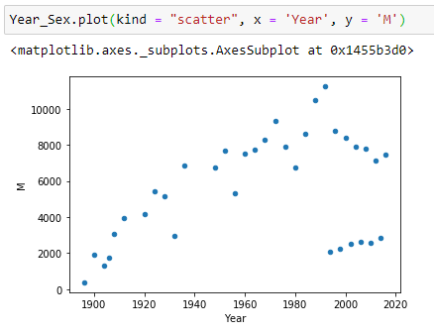
Scatter plot of Male Participants

Slide 50
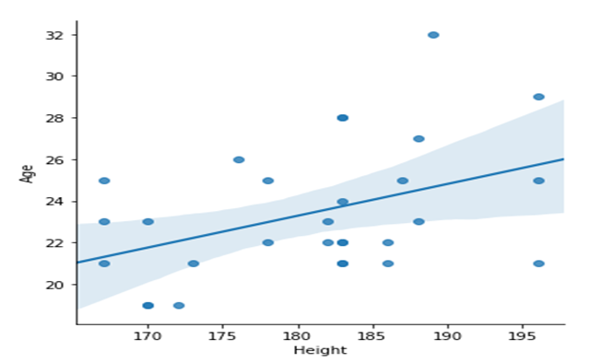
Age Height Ratio of track runners 100 mts

Slide 51
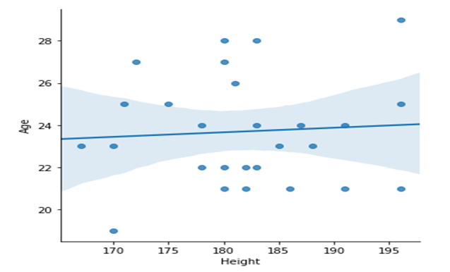
Age Height Ratio of track runners 200 mts

Slide 52
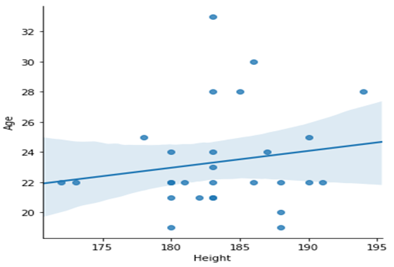
Age Height Ratio of track runners 400 mts

Slide 54
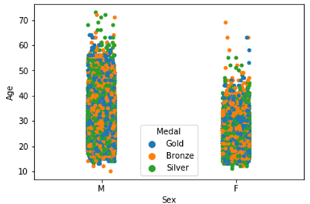
Agewise Sexwise Distribution of Medals

Slide 55

Heatmap showing correlation coefficients

Slide 56

Summer Games Participation

Slide 57

Winter Games Participation

Slide 58

Jointplot-Showing Female yearwise sorted

Slide 59

Jointplot-Showing Male yearwise sorted

Slide 60

Scatter plot-Male Athlete by Year

Slide 61

Scatter plot-Female Athlete by Year

Slide 62



Slide 63


Women Sports Introduced Yearwise

Slide 64

Total Events vis-à-vis Women Sports and Events

Slide 65

Improvement in Women Participation

Slide 66
Thank You
Please do review following.
https://www.kaggle.com/vijayprakashverma/plotly-tutorial-120-years-of-olympic-games
https://community.cloud.databricks.com/?o=8250381055806349#notebook/413093375443469/command/318359463018631

